Slide 1
DB Order Management
User Requirement Specification (URS)

Slide 2
DB Order Management
Use Case ID:
Use Case Name:
Date:
Version:
1st Jan, 2016
1.0
DB Order Management
Use Case Description :
DB operator will edit the order before printing, then it will be delivered, after delivery it will be reconciled if required.
In the list view of sales order DB operator will see todays orders by default
DB operator can filter sales orders according to SO/ DSR , Route, Market, Outlet, Date Range & Status. When filter orders, user must see the filtered orders until the field is selected in search option.
DB operator can print invoice, deliver product & cancel the orders in bulk quantity
In the list view of orders, the orders will be different color if it has “GRB & Crate”
In For 24pcs =1 case/crate (system will show 1 crate). For 1 to 23 pcs GRB, system will not show any crate. Manual input should applied.
In previous record of sales order details “Received” amount of cash will be default as sales, Operator will edit amount as required. GRB and crate need to be due default if received then manually input.
DB operator will generate two type of report- 1. Receivable from Outlet & 2. Due from Outlet
GRB related sales order should be highlighted from list view.
Multiple GRB related orders cannot be delivered at a time. System should prevent delivering and closing but invoice can be printed.
Market/Rout/PSR wise challan print.
Visi-cooler entry option in separated menu from menu bar.
Report: Challan vs. Delivery
Other Sales Orders:
Ref. excel file(types of others sales)

Slide 3
DB House Oder management Flow
PSR Starts/
Submitted Orders received by DB
Create Other
Sales Orders
Login APK
Enters Rout,
Sub-rout, Outlet
View
Creates/Add
Sales Order/
MKT Return
Add
Edit
Cancel
View
Summery
Edit & Save
View
Submit/send to DB
Print (invoice and challan)
Reconciliation
Save

Slide 4
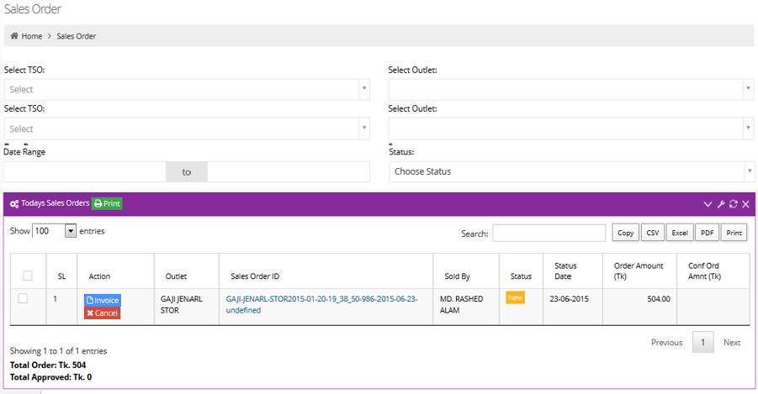
Sales Order View (DB) :
.
For multiple invoice printing/delivery select orders from check box then click on “Invoice/Deliver”
DB can also cancel any Sales Order.
Single orders cancellation should be from inside the sales orders.
Operator may change qty or add SKU before printing invoice.
Select PSR
Select Route
Select Market
Select Outlet
Search
Challan

Slide 5
Challan :
K.M. Enterprise
Sector -12, Road-3, Uttara, Dhaka.
Challan Report
Print Date & Time: 09 Jan 2016 01:55 PM
Section : Briddhi-1-Wednesday
Delivery Man : RA-01 Driver : DR-01
Delivery Date : 10-Dec-2015 PSR:
Route
Sub rout : Challan No
: Briddhi-1
: 1000002241012150069
SKU name in bangla font.
Challan will print rout or
market wise
Challan is the summery all invoices of selected invoices/rout/market
Challan print time pop up notification to input vehicle name, driver name and delivery man
Before challan printing, need to add additional qty of exising SKU and New SKU.
Code | SKU Name [Bangla] | Pack size | Issued | Ad diti on al Qty | 1st treap | 2nd treap | 3rd treap | Retur ned | Replace | Sales | TP | Value
86 | 7up 2000 ml (PET) | system | system |  |  |  |  |  |  |  | system | Only issued not TP
26 | Mirinda Orange 500 ml (PET)
77 | Mirinda Orange 1000 ml (PET)
131 | Mirinda Orange 250 ml (PET)
51 | Mango Slice 250 ml (GRB)
20 | 7up light 500 ml (PET)
75 | Pepsi 1000 ml (PET)
85 | Pepsi 2000 ml (PET)
Total
Total
Value Statement :
For Accounts :
Gross Sales Raw(cs) :
Issue + TP Case | PCS 119.00
Net Payable
:
Gross Sales (8Oz) :
Issue + TP Weight in Oz188.94
Credit Given (-)
:
Gross Sales (Value ) :
Issue Total Value 50,729.22
Prev Credit Collected (-) :
Free Sales value (-) :

Slide 6
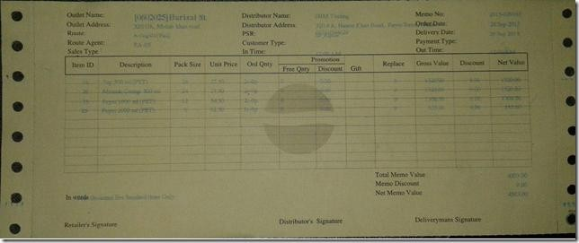
Invoice :
Note:
PSR Mobile Number
Invoice printing will be rout/market/single outlet wise but only after printing challan.
Owner address, owner name and SKU name, will be in Bengla.
Memo will be printed in open page.

Slide 7
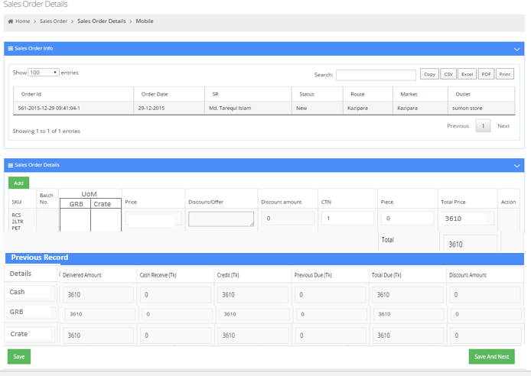

Sales Order Details (DB) :
DB can edit the sales order
from here-
Here in previous record “Received” cash amount/GRB/Crate will be default as sales, DB operator will edit the amount/QTY if needed to change.
UoM
GRB
Crate
Case
Pc
For GRB and Crate
Calculation:
For 24pcs =1 case/crate
(system will show 1 crate)
For 1 to 23 pcs GRB, system will not show any crate. Manual input should applied.
Total
Details
Delivered
Received Credit
Previous Due Total Due
3610

Slide 8
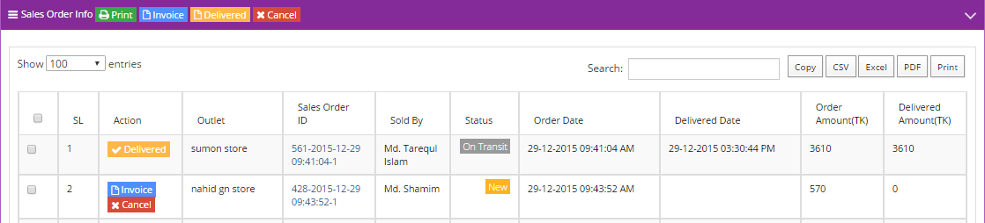
List View of Sales Order :
Challan
After printing invoice status will be “On Transit”
From action menu DB operator can deliver the order by clicking “Delivered” button

Slide 9
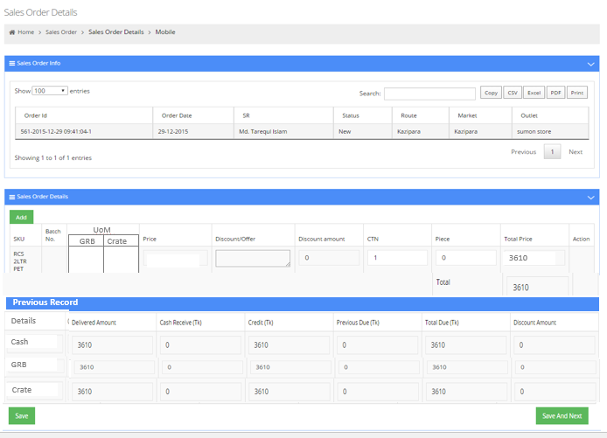
Reconciliation :
After Delivery the DB operator can reconcile the actual delivered quantity and click “Save” to update.
The actual delivered quantity will adjust automatically in the DB House Balance quantity.
UoM
GRB
Crate
Case
Pc
Total
Received Credit
Previous Due Total Due
3610

Slide 10
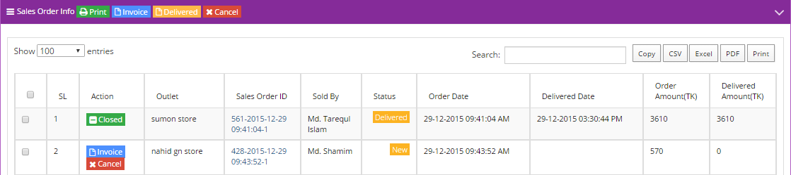
Delivery Status :
Challan
After delivery, action will be “Closed” and status will be “Delivered”

Slide 11








Visicular Manue :
DB View
Create New
SL | Visicooler Outlet Name | Sub-route | Route | Date of collection | Purity % | Charging % | Image
1
2
3
Collected visi- cooler information will be shown.
DB user can entry visi-cooler visit
DB View
Purity and Charging % gap is 5.
That is 1-5, 6-10, 11-15….
Image capturing is optional.
User will input manually in Purity
and Charging fields.
Only Visicooler Outlet will view the
Visi-cooler menu.
Rout
Sub Brand Outlet
Image
Upload
Purity
--%
Charging
--%
Save

Slide 12
Thank You

